Slide 1
Structural Analysis Task
Kari Dickerson
kari.dickerson@intergraph.com
July 2006

Slide 2
Structural Analysis Workflow
Place structural members using the Structure Task
Create an analysis model
Define load cases, load combinations and loads
Define boundary conditions and member releases
Create a CIS file to be analyzed and designed by a third party application
Update member section sizes based on third-party application analysis and design

Slide 3
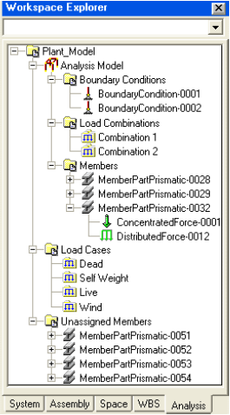
Analysis Model
A logical collection of member parts, boundary conditions and load combinations.
Non-graphical grouping of members that will be sent to an analysis and design program using CIMsteel Integration Standard (CIS) file.
Fixed hierarchy of load combinations, members and boundary conditions.
You must create an analysis model before you can define load combinations or boundary conditions.

Slide 4
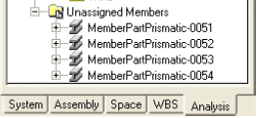
Analysis Model (Cont.)
Only member parts assigned to an analysis model are written to the CIS file.
Member parts are assigned to the analysis model using a Plant Filter.
Filter is applied against the database and not the workspace to ensure that member systems that pass the filter are found regardless of your current workspace definition.
Filter must be re-applied if members are added or removed.
Members with loads assigned that do not pass through the filter are put in the Unassigned Members folder.

Slide 5
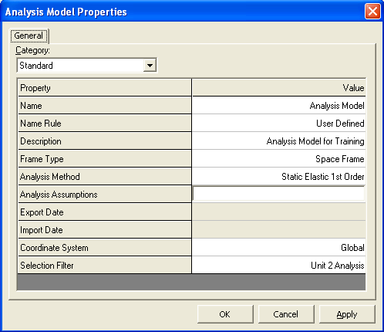
Create Analysis Model Command
In the Name box, type a name for the analysis model. If you do not specify a name, the name is generated based on a naming rule.
The members of an analysis model are based on members that belong to a filter. Select Create New Filter or click More to select an existing filter.

Slide 6
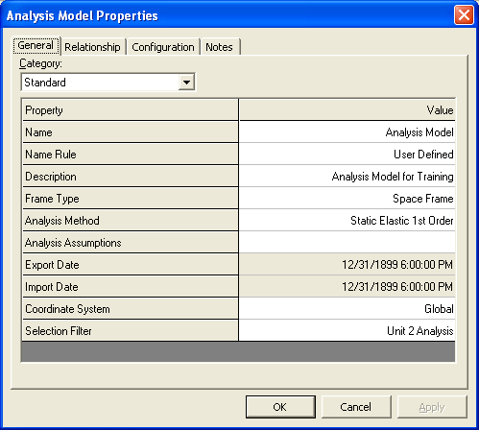
Analysis Model Ribbon and Properties
The Analysis Model Properties dialog box is used to set additional analysis model properties that are not available on the ribbon bar.
Apply Filter updates the members assigned to the analysis model using the filter selected.
The selection of the existing standard will “seed” all the sections in that standard. The user will edit the deviations.

Slide 7
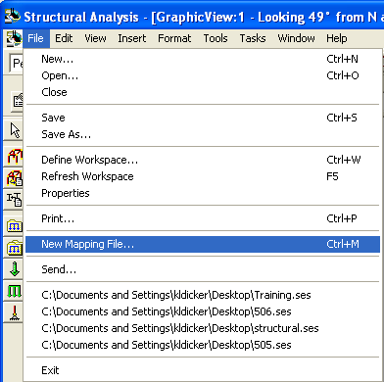
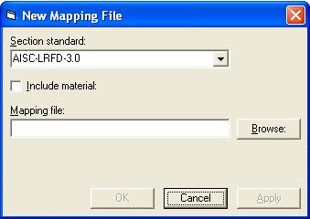
Mapping File Command
Creates an XML mapping file for the section names used in the software and third-party applications.
The mapping file created is a template. It must be edited and maintained by you.

Slide 8
Mapping File (Cont.)
The mapping file must be used if the third party analysis program you
are using calls the section standard a different name from what is
delivered with SmartPlant 3D's mapping file.
<SectionStandard>
<Standard name="AISC-LRFD-3.0" externalname="AISC-LRFD-3.0" externalorganization="AISC" externaldate="2002" externalversion="3.0" />
Must be replaced with the name of the Section Standard used by the third-party application. For example, if you are using STAAD:
<Standard name="AISC-LRFD-3.0" externalname="AISC EDI Standard Nomenclature" externalorganization="AISC" externaldate="2002" externalversion="3.0" />

Slide 9
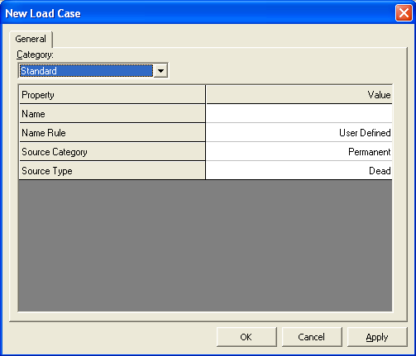
Load Case
Load cases are used to group loads based on their source.
Load cases are stored in the model.
To store load cases in the Catalog database, use the Copy to Catalog command.

Slide 10
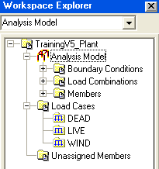
Load Case (Cont.)
The ribbon displays options for modifying a load case.
If you delete a load case, all loads placed using that load case are put in the To Do List as in error until a new load case is defined for the load.
If you delete a load case that is used in a load combination, the load combination is automatically edited to remove the deleted load case.

Slide 11
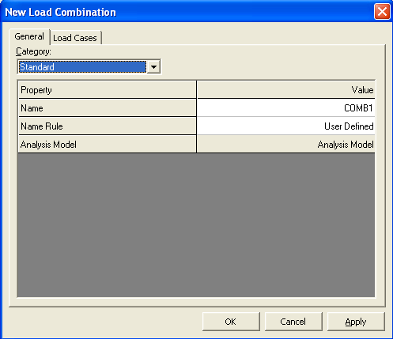
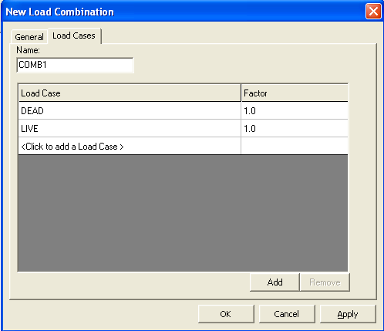
Load Combination
Define at least one load case before you define a load combination.
You can Add and Remove a Load Case from a Combination.

Slide 12

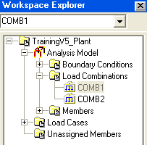
Load Combination (Cont.)
The ribbon displays options for modifying load combinations.
Load combinations are stored under the Analysis Model.

Slide 13

Concentrated Loads
Places a load that acts on a small area of a member.
Concentrated loads represent loads from other members, the weight of equipment, etc.
Only loads belonging to a load case that is part of a load combination definition are written to the CIS file.

Slide 14
Concentrated Loads (Cont.)
The Place Concentrated Loads command activates the smart step ribbon bar.
Select the member(s) to place the load and then select the location of the load along the member.
After placement, modification can be done through the properties page or the ribbon bar.

Slide 15

Distributed Loads
Places a load distributed along the full or partial length of a member.
The load source could be a wall resting on the member, a slab supported by the member, etc.
Only loads belonging to a load case that is part of a load combination definition are written to the CIS file.

Slide 16
Distributed Load (Cont.)
The Place Distributed Loads command activates the smart step ribbon bar.
Select the member(s) to place the load.
Select the start position and end position of the distributed load on the member(s).
After placement, modification can be done through the properties page or the ribbon bar.

Slide 17
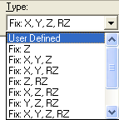
Boundary Conditions
  Defines the support conditions that occur between the end of a member and the ground.
  Supports are defined using the six degrees of freedom: X, Y, Z, RX, RY, and RZ.
  You can modify a boundary condition using the ribbon bar or the properties page.
Case 3:

Slide 18
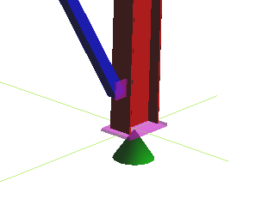
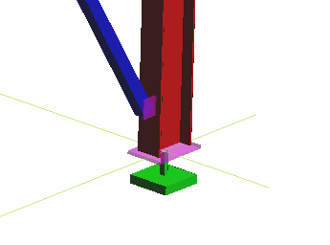
Boundary Conditions (Cont.)
Indicators for supports where RX, RY, and/or RZ are released look like this.
Indicators for fully fixed and RX, RY, and RZ fixed supports look like this.

Slide 19
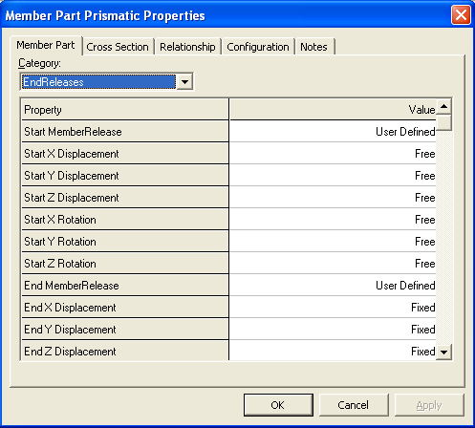
Member End Releases
Member end releases define how a structure is restrained from rigid body motion under the influence of external loads.
Supports are defined using the six degrees of freedom: X, Y, Z, RX, RY, and RZ.
Select the Member Part Properties and change the Category to EndReleases.

Slide 20
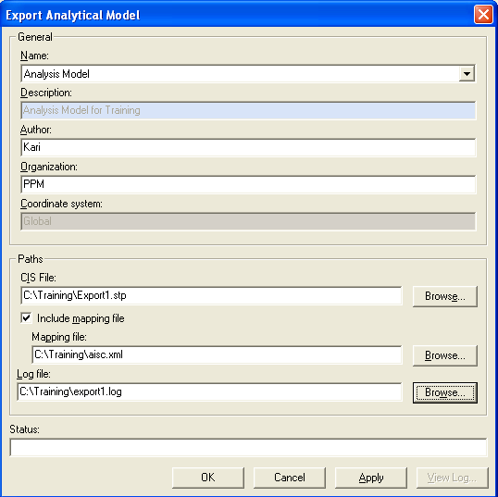
Export Analytical Model
The Export Analytical Model command opens the Export Analytical Model dialog box, which is used to write a CIMsteel Integration Standard (CIS/2) file that contains all the necessary analytical data to allow a third party program to import the finite element representation.
Workpoint Offsets are ignored.

Slide 21

Export Analytical Model (Cont.)
The Status Bar at the bottom of the dialog box will tell you if there are any errors or warnings in the log file.
The log file reports on error and warnings and gives you other information such as:
  Filename
  Creation Date
  Author
  Version of Translator
  Node Instances
  Element Instances
  Load Instances

Slide 22
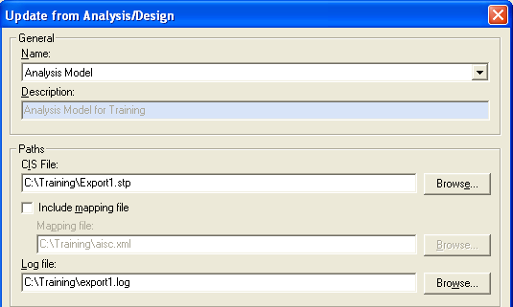
Update from Analysis/Design
The command opens the Update from Analysis/Design dialog box, which is used to read a CIMsteel Integration Standard (CIS/2 format) file.

Slide 23
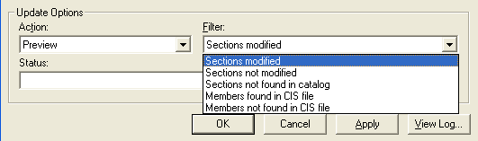
Update from Analysis/Design (Cont.)
  Select a filter to query against the information in the CIS file. Use this option with the Action option to compare the contents of the CIS to the Analysis Model members.
  This command will only update members if their section sizes are modified.
  Member topological changes, new loads, new load cases, and new load combinations are not read from the CIS file.

